Slide 1
SCSA3016-DATA SCIENCE Dr. P. SARDAR MARAN, Associate Professor, Dept.of CSE

Slide 2
Unit -2 PROBABILITY AND STATISTICS

Slide 3
What is Statistics ?
The field of Statistics deals with the collection, presentation, analysis, and use of data to make decisions, solve problems, and design products and processes.
Statistics is the science of learning from data, and of measuring, controlling, and communicating uncertainty; and it thereby provides the navigation essential for controlling the course of scientific and societal advances.
In simple terms, statistics is the science of data. Statistics is defined as collection , compilation ,analysis and interpretation of numerical data.
Statistics is the science of data

Slide 4
Where to Use Statistics?
In an agricultural study, researchers want to know which of four fertilizers (which vary in their nitrogen contents) produces the highest corn yield.
In a clinical trial, physicians want to determine which of two drugs is more effective for treating HIV in the early stages of the disease.
In a public health study, epidemiologists want to know whether smoking is linked to a particular demographic class in high school students.

Slide 5
Why Statistics?
To develop an appreciation for variability and how it effect product ,process and system.
It is estimating the present ; predicting the future
Study methods that can be used to solve problems ,build knowledge.
Statistics make data into information
Develop an understanding of some basic ideas of statistical reliability , stochastic process (probability concepts) .
Statistics is very important in every aspects of society (Govt., People or Business)

Slide 6
Basic terms
Variable: property with respect to which data from a sample differ in some measurable way
Measurement: assignment of numbers to something
Data: collection of measurements
Population : all possible data
Sample: collected data

Slide 7
Variable
A variable is a characteristic or condition that can change or take on different values.
Most research begins with a general question about the relationship between two variables for a specific group of individuals.

Slide 8
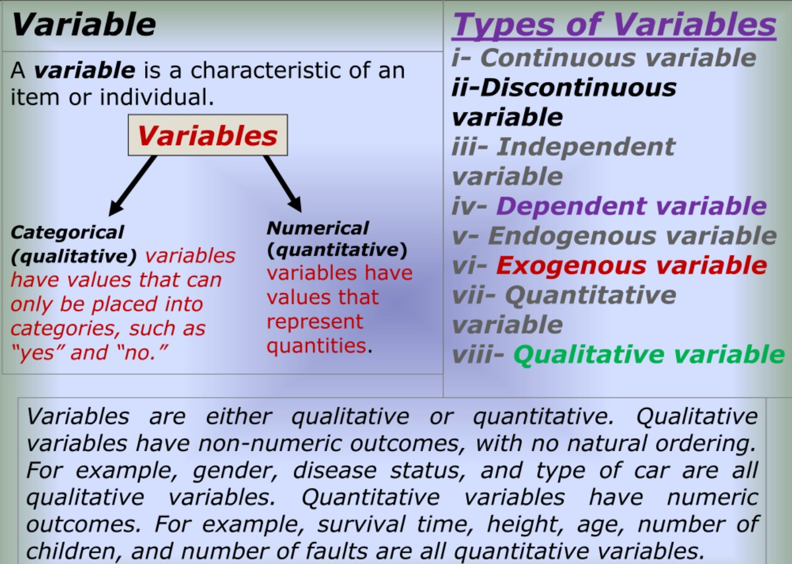

Slide 9
Types of Variables
Variables can be classified as discrete or continuous.
Discrete variables (such as class size) consist of indivisible categories, and
continuous variables (such as time or weight) are infinitely divisible into whatever units a researcher may choose. For example, time can be measured to the nearest minute, second, half-second, etc.

Slide 10
Measuring Variables
To establish relationships between variables, researchers must observe the variables and record their observations. This requires that the variables be measured.
The process of measuring a variable requires a set of categories called a scale of measurement and a process that classifies each individual into one category.

Slide 11
4 Types of Measurement Scales
A nominal scale is an unordered set of categories identified only by name. Nominal measurements only permit you to determine whether two individuals are the same or different.
An ordinal scale is an ordered set of categories. Ordinal measurements tell you the direction of difference between two individuals.

Slide 12
4 Types of Measurement Scales
3. An interval scale is an ordered series of equal-sized categories. Interval measurements identify the direction and magnitude of a difference. The zero point is located arbitrarily on an interval scale.
4. A ratio scale is an interval scale where a value of zero indicates none of the variable. Ratio measurements identify the direction and magnitude of differences and allow ratio comparisons of measurements.

Slide 13
Data
The measurements obtained in a research study are called the data.
The goal of statistics is to help researchers organize and interpret the data.

Slide 14
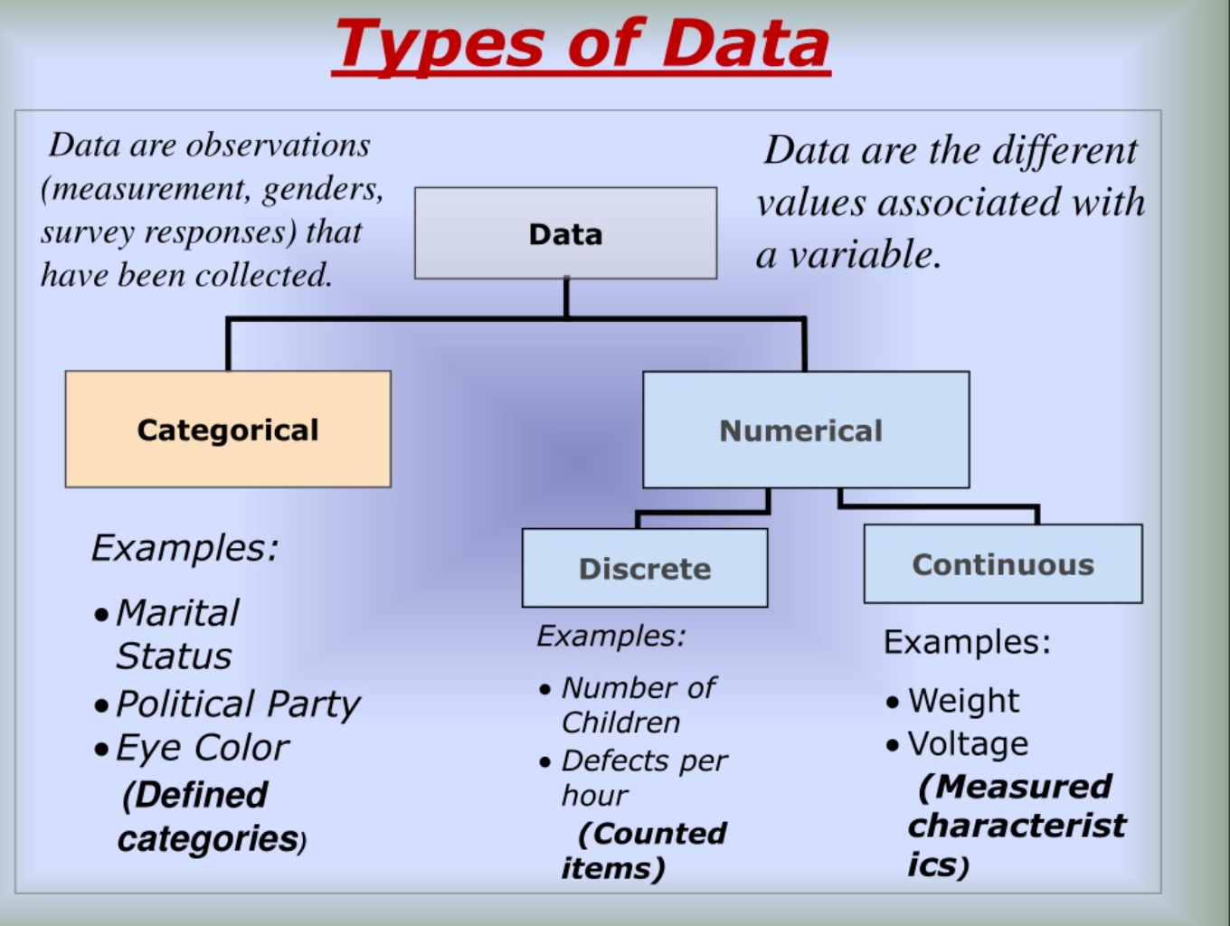

Slide 15
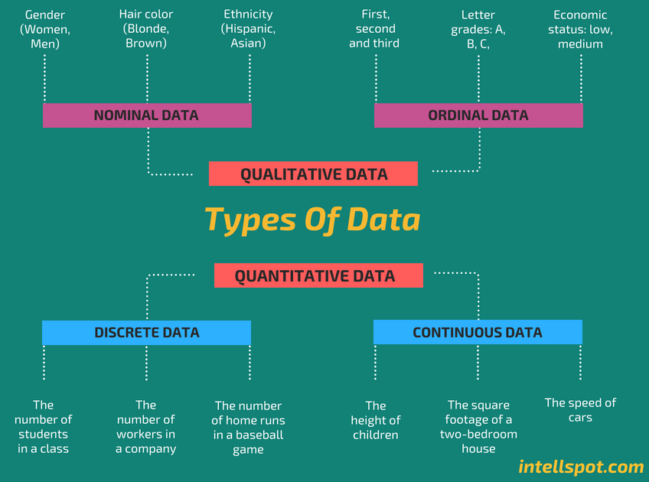

Slide 16
Quantitative
The data which are statistical or numerical are known as Quantitive data. Quantitive data is generated through. Quantitative data is also known as Structured data. Experiments, Tests, Surveys, Market Report.
Quantitive data is again divided into Continuous data and Discrete data.
Continuous Data
Continuous data is the data which can have any value. That means Continuous data can give infinite outcomes so it should be grouped before representing on a graph.
Examples
The speed of a vehicle as it passes a checkpoint
The mass of a cooking apple
The time taken by a volunteer to perform a task

Slide 17
Discrete Data
Discrete data can have certain values. That means only a finite number can be categorized as discrete data.
Numbers of cars sold at a dealership during a given month
Number of houses in certain block
Number of fish caught on a fishing trip
Number of complaints received at the office of airline on a given day
Number of customers who visit at bank during any given hour
Number of heads obtained in three tosses of a coin
Differences between Discrete and Continuous data
Numerical data could be either discrete or continuous
Continuous data can take any numerical value (within a range); For example, weight, height, etc.
There can be an infinite number of possible values in continuous data
Discrete data can take only certain values by finite ‘jumps’, i.e., it ‘jumps’ from one value to another but does not take any intermediate value between them (For example, number of students in the class

Slide 18
Qualitative
Data that deals with description or quality instead of numbers are known as Quantitative data. Qualitative data is also known as unstructured data. Because this type of data is loosely compact and can’t be analyzed conventionally.

Slide 19
Population
The entire group of individuals is called the population.
For example, a researcher may be interested in the relation between class size (variable 1) and academic performance (variable 2) for the population of third-grade children.

Slide 20
Sample
Usually populations are so large that a researcher cannot examine the entire group.
Therefore, a sample is selected to represent the population in a research study.
The goal is to use the results obtained from the sample to help answer questions about the population.

Slide 21
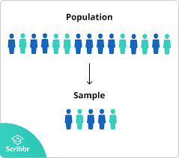
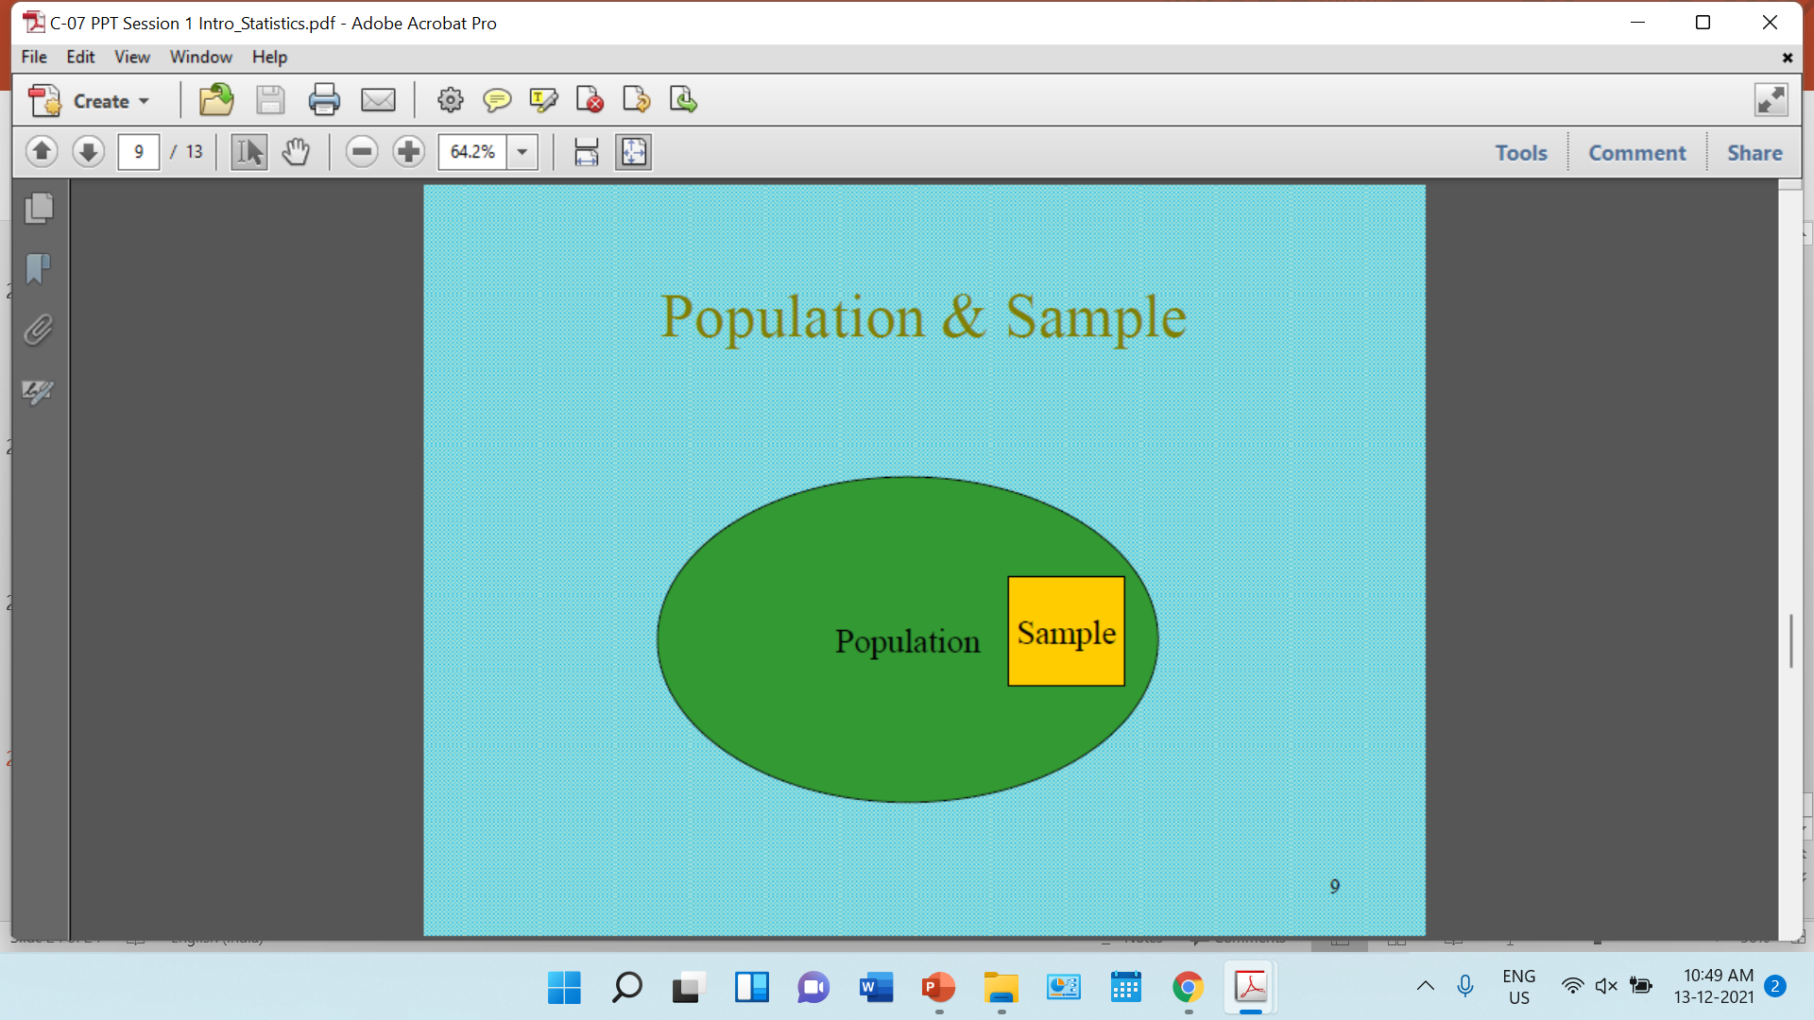

Slide 22
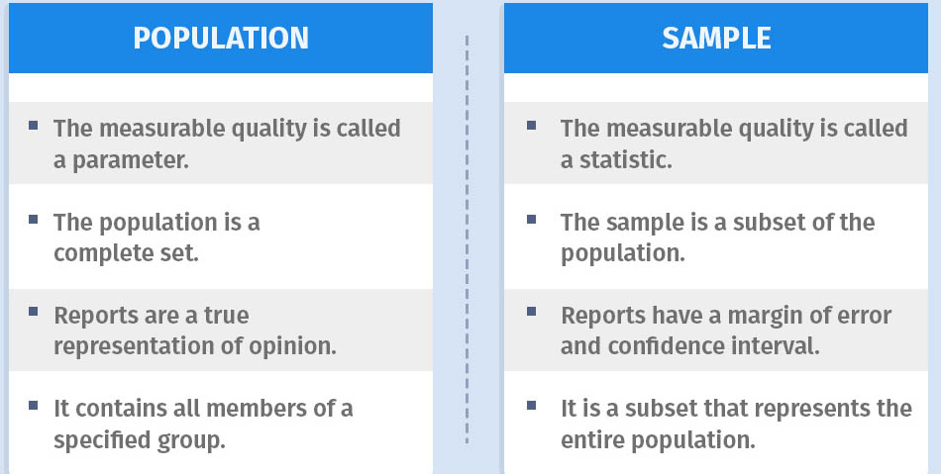

Slide 23
Sampling Error
The discrepancy between a sample statistic and its population parameter is called sampling error.
Defining and measuring sampling error is a large part of inferential statistics.

Slide 24
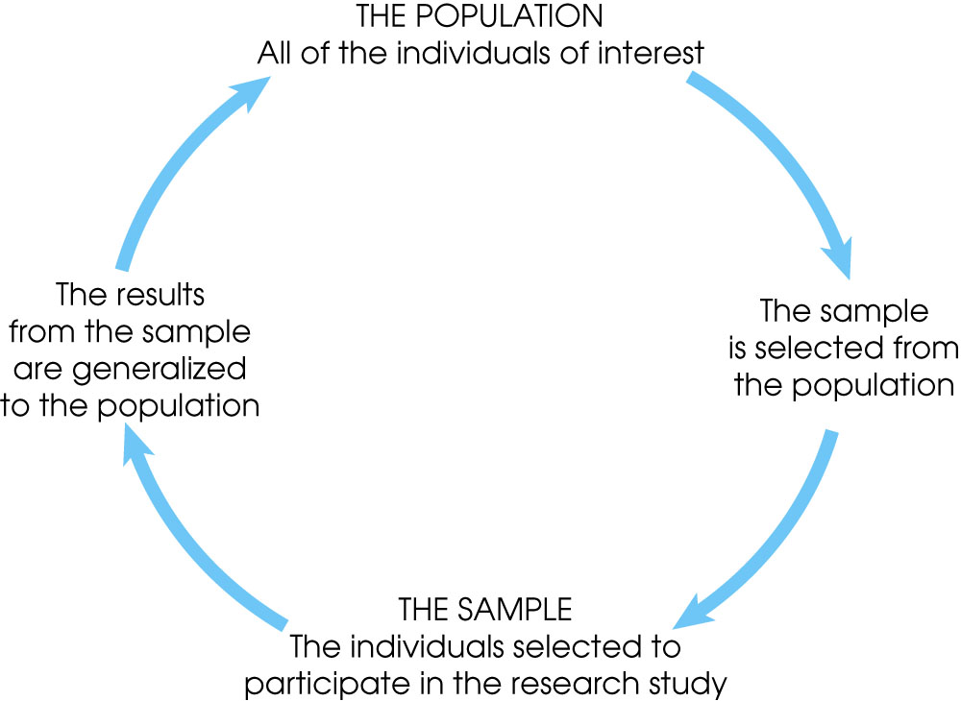

Slide 25
Frequency Distribution
Frequency Distribution (or Frequency Table)
Shows how a data set is partitioned among all of several categories (or classes) by listing all of the categories along with the number (frequency) of data values in each of them

Slide 26
Frequency Distribution
When data are in original form, they are called raw data
Organizing Data:
Categorical distribution
Grouped distribution
Ungroupde distribution

Slide 27
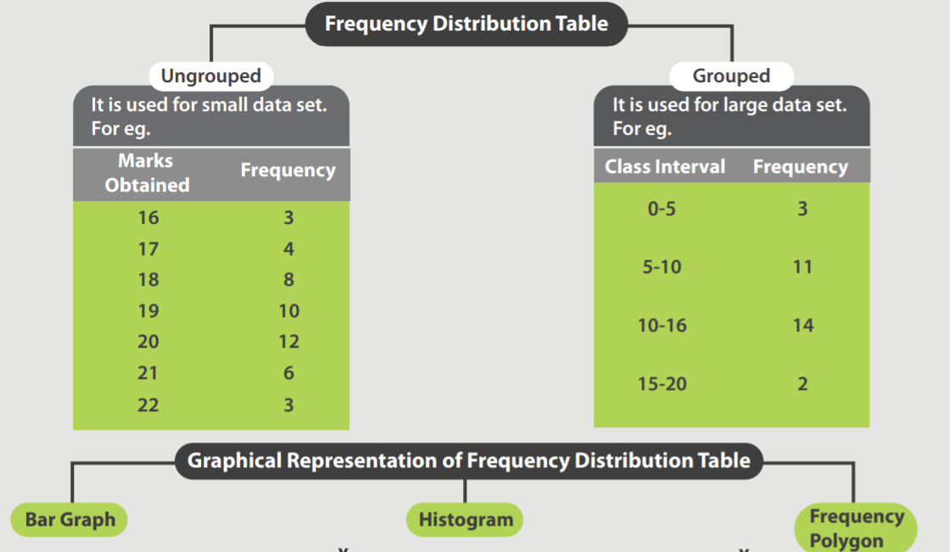

Slide 28
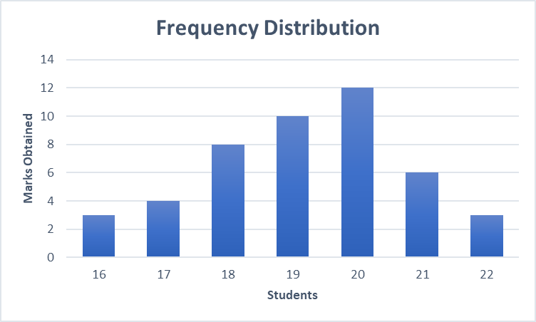
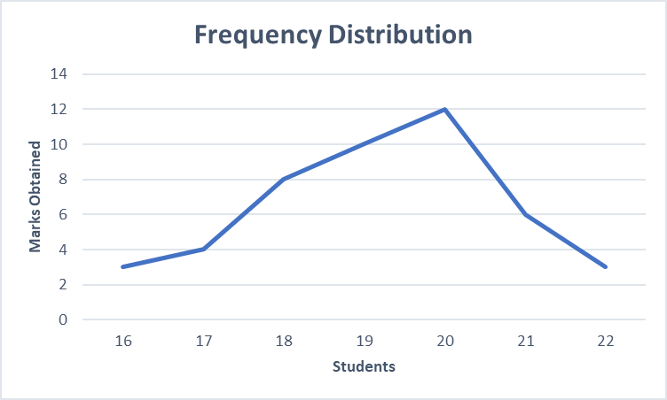
BAR CHART
LINE CHART

Slide 29
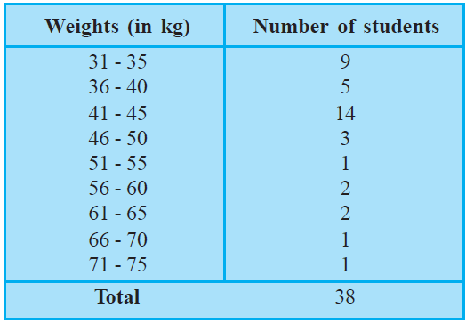
Frequency distribution refers to data classified on the basis of some variable that can be measured such as prices, weight, height, wages etc.

Slide 30
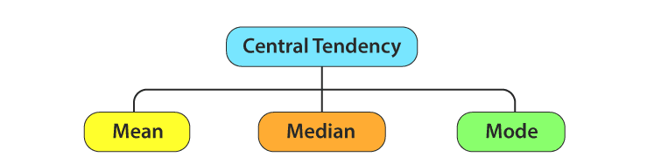
Measures of Centre Tendency
In statistics, the central tendency is the descriptive summary of a data set.
Through the single value from the dataset, it reflects the centre of the data distribution.
Moreover, it does not provide information regarding individual data from the dataset, where it gives a summary of the dataset. Generally, the central tendency of a dataset can be defined using some of the measures in statistics.

Slide 31
Mean
The mean represents the average value of the dataset.
It can be calculated as the sum of all the values in the dataset divided by the number of values. In general, it is considered as the arithmetic mean.
Some other measures of mean used to find the central tendency are as follows:
Geometric Mean (nth root of the product of n numbers)
Harmonic Mean (the reciprocal of the average of the reciprocals)
Weighted Mean (where some values contribute more than others)
It is observed that if all the values in the dataset are the same, then all geometric, arithmetic and harmonic mean values are the same. If there is variability in the data, then the mean value differs.

Slide 32
Calculating the Mean
Calculate the mean of the following data: 1 5 4 3 2
Sum the scores (ΣX): 1 + 5 + 4 + 3 + 2 = 15
Divide the sum (ΣX = 15) by the number of scores (N = 5): 15 / 5 = 3
Mean = X = 3

Slide 33
The Median
The median is simply another name for the 50th percentile
Sort the data from highest to lowest
Find the score in the middle
If N, the number of scores, is even the median is the average of the middle two scores

Slide 34
Median Example
What is the median of the following scores: 10 8 14 15 7 3 3 8 12 10 9
Sort the scores: 15 14 12 10 10 9 8 8 7 3 3
Determine the middle score: middle = (N + 1) / 2 = (11 + 1) / 2 = 6
Middle score = median = 9

Slide 35
Median Example
What is the median of the following scores: 24 18 19 42 16 12
Sort the scores: 42 24 19 18 16 12
Determine the middle score: middle = (N + 1) / 2 = (6 + 1) / 2 = 3.5
Median = average of 3rd and 4th scores: (19 + 18) / 2 = 18.5

Slide 36
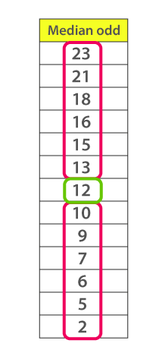
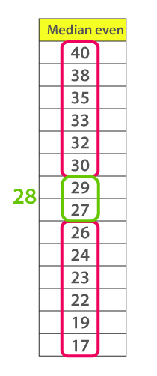
For even scores the average of
two scores is the Median value

Slide 37
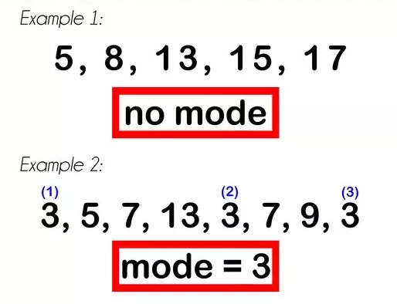
Mode
The mode is the score that occurs most frequently in a set of data.
There may be a bimode
will also presented in the score.
(i.e two modes)
Ex: (3,4,7,3,7,5,8)
Bimode: (3,7)

Slide 38
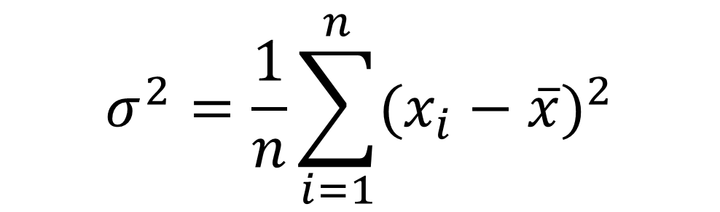
Variance
Variance is the average squared deviation from the mean of a set of data.
It is used to find the Standard deviation.
$$σ^{2}=\frac{1}{n}\sum_{i=1}^{n}{{(x_{i}−\overline{x})}^{2}}$$

Slide 39
Variance
This is a good measure of how much variation exists in the sample, normalized by sample size.
It has the nice property of being additive.
The only problem is that the variance is measured in units squared

Slide 40
How to find Variance
Find the Mean of the data.
Subtract the mean from each value – the result is called the deviation from the mean.
Square each deviation of the mean.
Find the sum of the squares.
Divide the total by the number of items.

Slide 41
How to find Variance? - Example
Suppose you're given the data set 1, 2, 2, 4, 6. ( X = 1,2,2,4,6) One Variable X
Calculate the mean of your data set. The mean of the data is (1+2+2+4+6)/5
Mean= 15/5 = 3.
Subtract the mean from each of the data values and list the differences. Subtract 3 from each of the values 1, 2, 2, 4, 6
1-3 = -2 2-3 = -1 2-3 = -1 4-3 = 1 6-3 = 3
Your list of differences is -2, -1, -1, 1, 3 (deviation)
You need to square each of the numbers -2, -1, -1, 1, 3 (-2)² = 4, (-1)² = 1, (-1)² = 1, (1)² = 1, (3)² = 9
Your list of squares is 4, 1, 1, 1, 9, Add the squares 4+1+1+1+9 = 16
Subtract one from the number of data values you started with. You began this process (it may seem like a while ago) with five data values. One less than this is 5-1 = 4.
Divide the sum from step four by the number from step five. The sum was 16, and the number from the previous step was 4. You divide these two numbers 16/4 = 4.

Slide 42
Variation in one variable
So, these four measures all describe aspects of the variation in a single variable:
a. Sum of the squared deviations
b. Variance
c. Standard deviation
d. Standard error •
Can we adapt them for thinking about the way in which two variables might vary together?

Slide 43
Covariance
In mathematics and statistics, covariance is a measure of the relationship between two random variables. (X, Y)
More precisely, covariance refers to the measure of how two random variables in a data set will change together.
Positive covariance: Indicates that two variables tend to move in the same direction.
Negative covariance: Reveals that two variables tend to move in inverse directions.

Slide 44
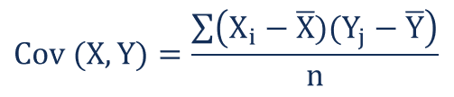
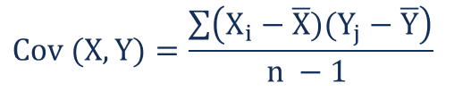
The covariance between two random variables X and Y can be calculated using the following formula (for population):
For a sample covariance, the formula is slightly adjusted:
Where:
X_{i} – the values of the X-variable
Y_{j} – the values of the Y-variable
X̄ – the mean (average) of the X-variable
Ȳ – the mean (average) of the Y-variable
n – the number of data points

Slide 45
Covariance Example
Example 1: Find covariance for following data set (Two Variables X and Y)
X = {2,5,6,8,9}, Y = {4,3,7,5,6}
Solution:
Given data sets X = {2,5,6,8,9}, Y = {4,3,7,5,6} and N = 5
Mean(X) = (2 + 5 + 6 + 8 + 9) / 5 = 30 / 5 = 6
Mean(Y) = (4 + 3 +7 + 5 + 6) / 5 = 25 / 5 = 5
Sample covariance Cov(X,Y) = ∑(X_{i} - X ) × (Y_{i} - Y)/ (N - 1)
= [(2 - 6)(4 - 5) + (5 - 6)(3 - 5) + (6 - 6)(7 - 5) + (8 - 6)(5 - 5) +
(9 - 6)(6 - 5)] / 5 - 1
= 4 + 2 + 0 + 0 + 3 / 4 = 9 / 4 = 2.25

Slide 46
Population covariance Cov(X,Y) = ∑(X_{i} - X ) × (Y_{i} - Y)/ (N)
= [(2 - 6)(4 - 5) + (5 - 6)(3 - 5) + (6 - 6)(7 - 5) + (8 - 6)(5 - 5) + (9 - 6)(6 - 5)] / 5
= 4 + 2 + 0 + 0 + 3 /5
= 9 / 5
= 1.8
Answer: The sample covariance is 2.25 and the population covariance is 1.8

Slide 47
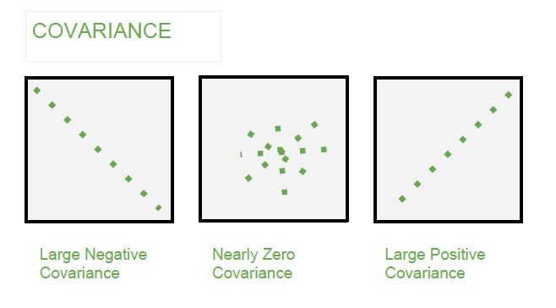
Positive and Negative Covariance

Slide 48
Covariance Matrix
The covariance matrix is a math concept that occurs in several areas of machine learning.
If you have a set of n numeric data items, where each data item has d dimensions, then the covariance matrix is a d-by-d symmetric square matrix where there are variance values on the diagonal and covariance values off the diagonal.
Suppose you have a set of n=5 data items, representing 5 people, where each data item has a Height (X), test Score (Y), and Age (Z) (therefore d = 3):

Slide 49
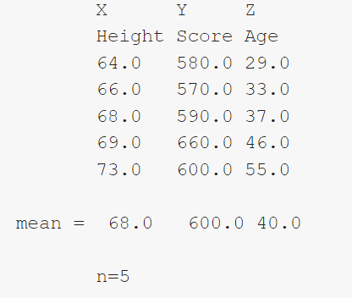
Covariance Matrix

Slide 50
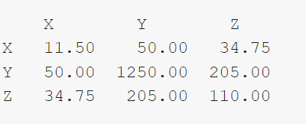
Covariance Matrix
The 11.50 is the variance of X, 1250.0 is the variance of Y, and 110.0 is the variance of Z. For variance, in words, subtract each value from the dimension mean. Square, add them up, and divide by n-1. For example, for X:
Var(X) = [ (64–68.0)^2 + (66–68.0^2 + (68-68.0)^2 + (69-68.0)^2 +(73-68.0)^2 ] / (5-1) = (16.0 + 4.0 + 0.0 + 1.0 + 25.0) / 4 = 46.0 / 4 = 11.50.
The covariance matrix for this data set is:

Slide 51
Covariance Matrix
Covar(XY) =
[ (64-68.0)*(580-600.0) + (66-68.0)*(570-600.0) + (68-68.0)*(590-600.0) + (69-68.0)*(660-600.0) + (73-68.0)*(600-600.0) ] / (5-1) =
[80.0 + 60.0 + 0 + 60.0 + 0] / 4 =
200 / 4 = 50.0
If you examine the calculations carefully, you’ll see the pattern to compute the covariance of the XZ and YZ columns. And you’ll see that Covar(XY) = Covar(YX).

Slide 52
Standard Deviation
Variability is a term that describes how spread out a distribution of scores (or darts) is.
Variance and standard deviation are closely related ways of measuring, or quantifying, variability.
Standard deviation is simply the square root of variance
Find the mean (or arithmetic average) of the scores. To find the mean, add up the scores and divide by n where n is the number of scores.
Find the sum of squared deviations (abbreviated SSD). To get the SSD, find the sum of the squares of the differences (or deviations) between the mean and all the individual scores.
Find the variance. If you are told that the set of scores constitute a population, divide the SSD by n to find the variance. If instead you are told, or can infer, that the set of scores constitute a sample, divide the SSD by (n – 1) to get the variance.
Find the standard deviation. To get the standard deviation, take the square root of the variance.

Slide 53
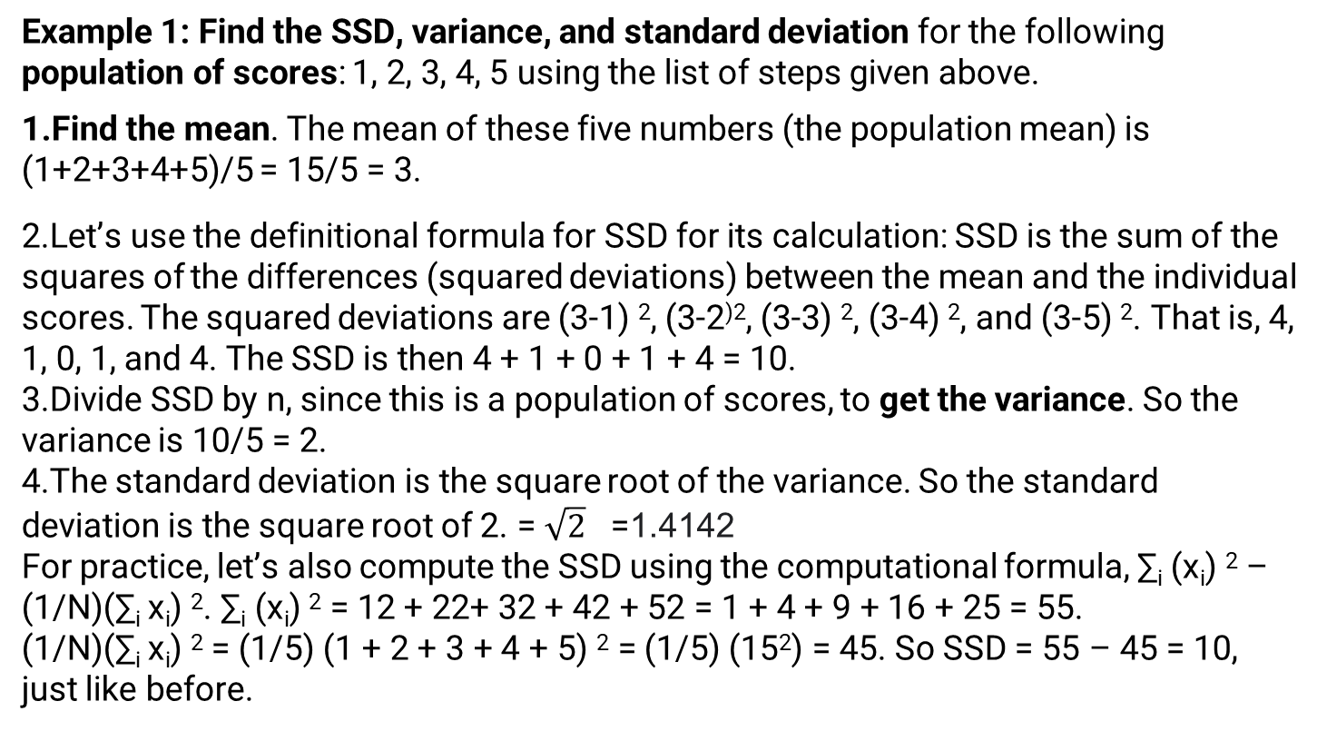
How to find Standard Deviation – Example (in Population score)
Example 1: Find the SSD, variance, and standard deviation for the following population of scores: 1, 2, 3, 4, 5 using the list of steps given above.
Find the mean. The mean of these five numbers (the population mean) is (1+2+3+4+5)/5 = 15/5 = 3.
Let’s use the definitional formula for SSD for its calculation: SSD is the sum of the squares of the differences (squared deviations) between the mean and the individual scores. The squared deviations are (3-1) ², (3-2⁾², (3-3) ², (3-4) ², and (3-5) ². That is, 4, 1, 0, 1, and 4. The SSD is then 4 + 1 + 0 + 1 + 4 = 10.
Divide SSD by n, since this is a population of scores, to get the variance. So the variance is 10/5 = 2.
The standard deviation is the square root of the variance. So the standard deviation is the square root of 2. = $\sqrt{2}$ =1.4142
For practice, let’s also compute the SSD using the computational formula, ∑_{i} (x_{i}) ² – (1/N)(∑_{i} x_{i}) ². ∑_{i} (x_{i}) ² = 12 + 22+ 32 + 42 + 52 = 1 + 4 + 9 + 16 + 25 = 55. (1/N)(∑_{i} x_{i}) ² = (1/5) (1 + 2 + 3 + 4 + 5) ² = (1/5) (15²) = 45. So SSD = 55 – 45 = 10, just like before.

Slide 54
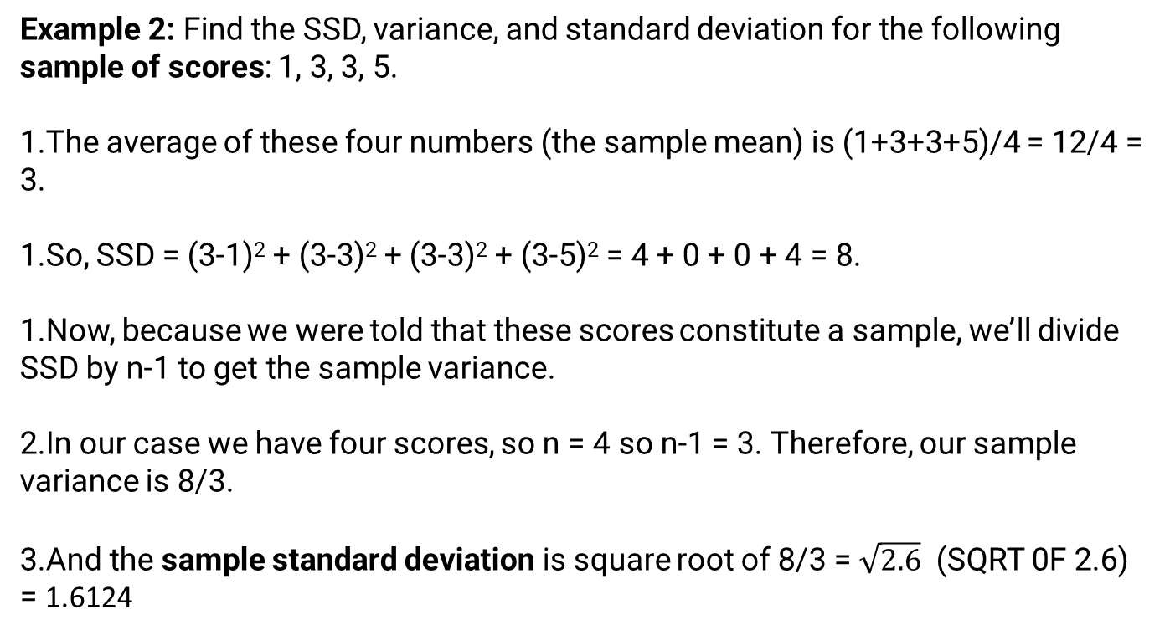
How to find Standard Deviation – Example (in Sample score)
Example 2: Find the SSD, variance, and standard deviation for the following sample of scores: 1, 3, 3, 5.
The average of these four numbers (the sample mean) is (1+3+3+5)/4 = 12/4 = 3.
So, SSD = (3-1)² + (3-3)² + (3-3)² + (3-5)² = 4 + 0 + 0 + 4 = 8.
Now, because we were told that these scores constitute a sample, we’ll divide SSD by n-1 to get the sample variance.
In our case we have four scores, so n = 4 so n-1 = 3. Therefore, our sample variance is 8/3.
And the sample standard deviation is square root of 8/3 = $\sqrt{2.6}$ (SQRT 0F 2.6) = 1.6124

Slide 55
What is Distribution in statistics?
A distribution is simply a collection of data, or scores, on a variable. Usually, these scores are arranged in order from smallest to largest and then they can be presented graphically.
A distribution is an arrangement of values of a variable showing their observed or theoretical frequency of occurrence.
A bell curve showing how the class did on our last exam would be an example of a distribution.
All distributions can be characterized by the following two dimensions:
Central Tendency: Mean, Median and Mode(s) of the distribution
Variability: All distributions have a variance and standard deviation

Slide 56
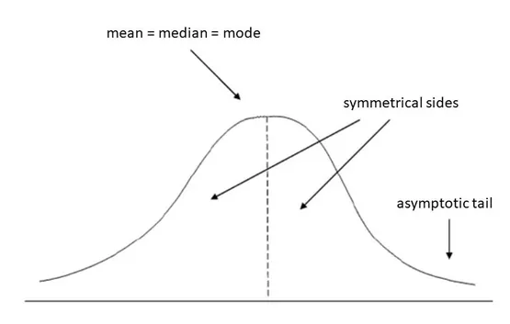
Bell Curve
The term bell curve is used to describe the mathematical concept called normal distribution, sometimes referred to as Gaussian distribution.
"Bell curve" refers to the bell shape that is created when a line is plotted using the data points for an item that meets the criteria of normal distribution.
In a bell curve, the center contains the greatest number of a value and, therefore, it is the highest point on the arc of the line. This point is referred to the mean, but in simple terms, it is the highest number of occurrences of an element (in statistical terms, the mode).

Slide 57
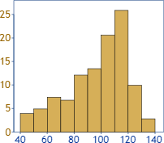
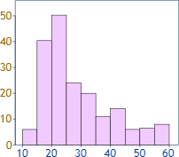
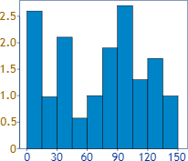
Distribution
Data can be "distributed" (spread out) in different ways.
It can be spread out more on the left
more on the
right
it can be all jumbled up

Slide 58
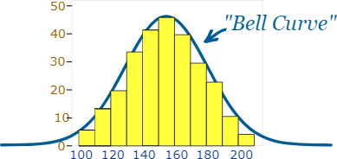
But there are many cases where the data tends to be around a central value with no bias left or right, and it gets close to a "Normal Distribution" like this:

Slide 59
Normal Distribution
Normal distribution: a bell-shaped, symmetrical distribution in which the mean, median and mode are all equal Z scores (also known as standard scores): the number of standard deviations that a given raw score falls above or below the mean Standard normal distribution: a normal distribution represented in z scores. The standard normal distribution always has a mean of zero and a standard deviation of one.

Slide 60
Normal Distribution
The normal distribution is an important class of Statistical Distribution that has a wide range of applications. This distribution applies in most Machine Learning Algorithms and the concept of the Normal Distribution is a must for any Statistician, Machine Learning Engineer, and Data Scientist.
Parameters of Normal Distribution
Mean
Standard Deviation
Properties of Normal Distribution
Symmetricity
Measures of Central Tendencies are equal
Empirical Rule
Skewness and Kurtosis
The area under the curve

Slide 61
Properties of Normal Distribution
All forms of the normal distribution share the following characteristics:
1. It is symmetric
The shape of the normal distribution is perfectly symmetrical.
This means that the curve of the normal distribution can be divided from the middle and we can produce two equal halves. Moreover, the symmetric shape exists when an equal number of observations lie on each side of the curve.
2. The mean, median, and mode are equal
The midpoint of normal distribution refers to the point with maximum frequency i.e., it consists of most observations of the variable.
The midpoint is also the point where all three measures of central tendency fall. These measures are usually equal in a perfectly shaped normal distribution.

Slide 62
Properties of Normal Distribution
3. Empirical rule
In normally distributed data, there is a constant proportion of data points lying under the curve between the mean and a specific number of standard deviations from the mean.
Thus, for a normal distribution, almost all values lie within 3 standard deviations of the mean.
These check buttons of normal distribution will help you realize the appropriate percentages of the area under the curve.
Remember that this empirical rule applies to all normal distributions. Also, note that these rules are applied only to the normal distributions.

Slide 63
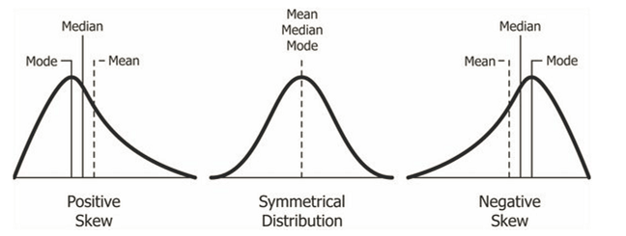
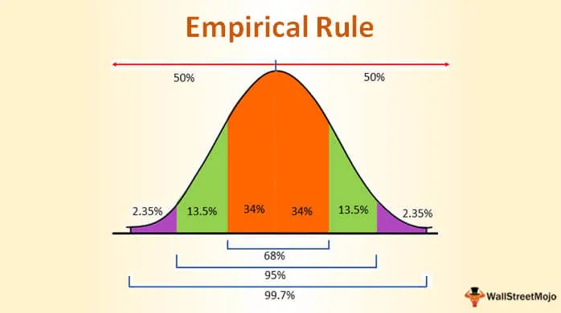

Slide 64
Many things closely follow a Normal Distribution
Example:
Heights of people
Size of things produced by machines
Errors in measurements
Blood pressure
Marks on a test

Slide 65
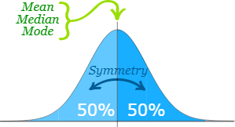
Normal Distribution
We say the data is "normally distributed":
The Normal Distribution has:
mean = median = mode
symmetry about the center
50% of values less than the mean and 50% greater than the mean

Slide 66
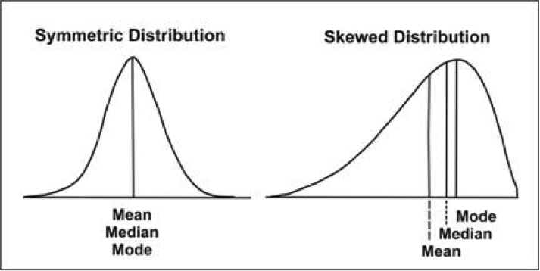
The normal distribution is a bell-shaped, symmetrical distribution in which the mean, median and mode are all equal. If the mean, median and mode are unequal, the distribution will be either positively or negatively skewed. Consider the illustration below:

Slide 67
Probability Density
Given a random variable, we are interested in the density of its probabilities.
For example, given a random sample of a variable, we might want to know things like the shape of the probability distribution, the most likely value, the spread of values, and other properties.
Knowing the probability distribution for a random variable can help to calculate moments of the distribution, like the mean and variance, but can also be useful for other more general considerations, like determining whether an observation is unlikely or very unlikely and might be an outlier or anomaly.
The problem is, we may not know the probability distribution for a random variable.
We rarely do know the distribution because we don’t have access to all possible outcomes for a random variable. In fact, all we have access to is a sample of observations. As such, we must select a probability distribution.
This problem is referred to as probability density estimation, or simply “density estimation,” as we are using the observations in a random sample to estimate the general density of probabilities beyond just the sample of data we have available.

Slide 68
Probability Density
A random variable x has a probability distribution p(x).
The relationship between the outcomes of a random variable and its probability is referred to as the probability density, or simply the “density.”
If a random variable is continuous, then the probability can be calculated via probability density function, or PDF for short.
The shape of the probability density function across the domain for a random variable is referred to as the probability distribution and common probability distributions have names, such as uniform, normal, exponential, and so on.

Slide 69
There are a few steps in the process of density estimation for a random variable.
The first step is to review the density of observations in the random sample with a simple histogram.
From the histogram, we might be able to identify a common and well-understood probability distribution that can be used, such as a normal distribution. If not, we may have to fit a model to estimate the distribution.

Slide 70
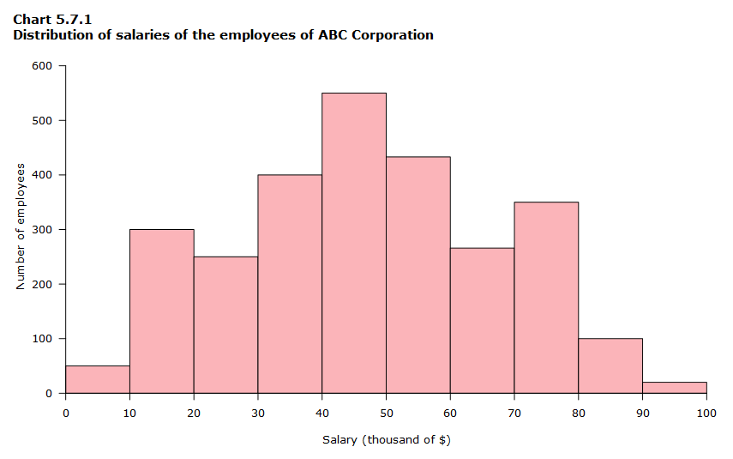
Histogram

Slide 71
Density With a Histogram
The first step in density estimation is to create a histogram of the observations in the random sample.
A histogram is a plot that involves first grouping the observations into bins and counting the number of events that fall into each bin.
The counts, or frequencies of observations, in each bin are then plotted as a bar graph with the bins on the x-axis and the frequency on the y-axis.
The choice of the number of bins is important as it controls the coarseness of the distribution (number of bars) and, in turn, how well the density of the observations is plotted.
It is a good idea to experiment with different bin sizes for a given data sample to get multiple perspectives or views on the same data.

Slide 72
Univariate Normal Distributions
Before defining the multivariate normal distribution we will visit the univariate normal distribution. A random variable X is normally distributed with mean μ and variance σ2 if it has the probability density function of X as:
ϕ(x)=12πσ2exp⁡{−12σ2(x−μ)2}
This result is the usual bell-shaped curve that you see throughout statistics.
In this expression, you see the squared difference between the variable x and its mean, μ. This value will be minimized when x is equal to μ. The quantity −σ−2(x−μ)2 will take its largest value when x is equal to μ or likewise, since the exponential function is a monotone function, the normal density takes a maximum value when x is equal to μ.
The variance σ2 defines the spread of the distribution about that maximum. If σ2 is large, then the spread is going to be large, otherwise, if the σ2 value is small, then the spread will be small.

Slide 73
Multivariate analysis is a branch of statistics concerned with the analysis of multiple measurements, made on one or several samples of individuals. For example, we may wish to measure length, width, and weight of a product.
Multivariate statistical analysis is concerned with data that consist of sets of measurements On a number of individuals or objects.
The sample data may be heights and weights of some individuals drawn randomly from a population of school children in a given city, or the statistical treatment may be made on a collection of measurements

Slide 74
"Why is the multivariate normal distribution so important?“
There are three reasons why this might be so:
Mathematical Simplicity. It turns out that this distribution is relatively easy to work with, so it is easy to obtain multivariate methods based on this particular distribution.
Multivariate version of the Central Limit Theorem. You might recall in the univariate course that we had a central limit theorem for the sample mean for large samples of random variables. A similar result is available in multivariate statistics that says if we have a collection of random vectors X1,X2,⋯Xn that are independent and identically distributed, then the sample mean vector, x¯, is going to be approximately multivariate normally distributed for large samples.
Many natural phenomena may also be modeled using this distribution, just as in the univariate case.

Slide 75
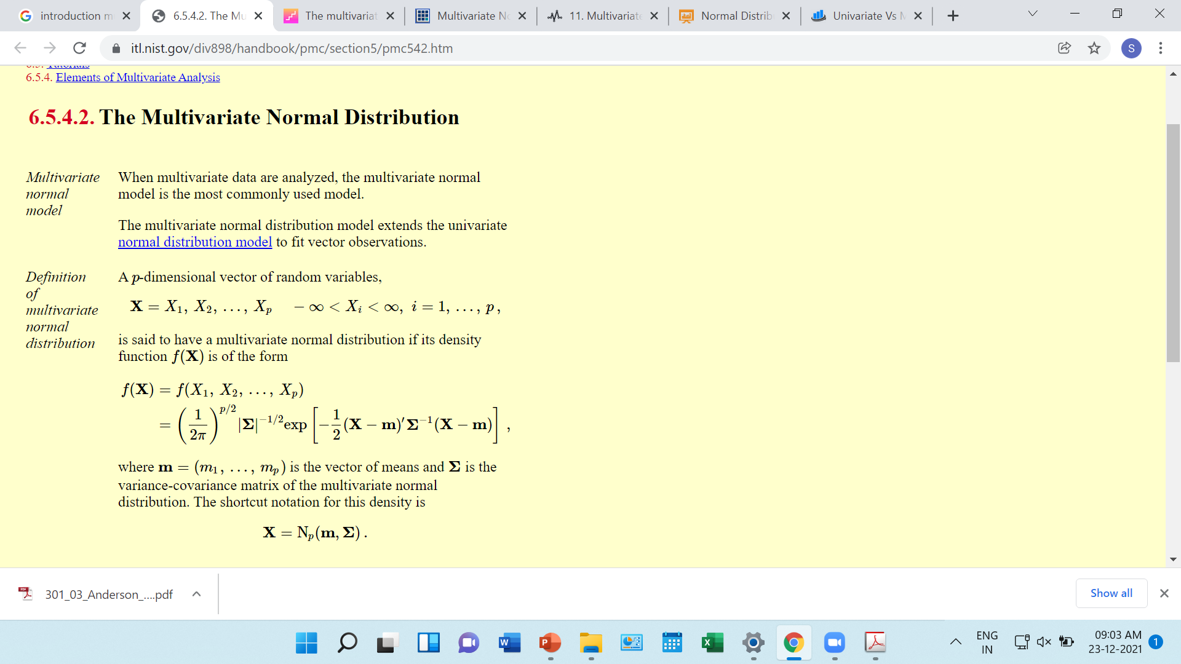

Slide 76
Correlational Studies
The goal of a correlational study is to determine whether there is a relationship between two variables and to describe the relationship.
A correlational study simply observes the two variables as they exist naturally.

Slide 77
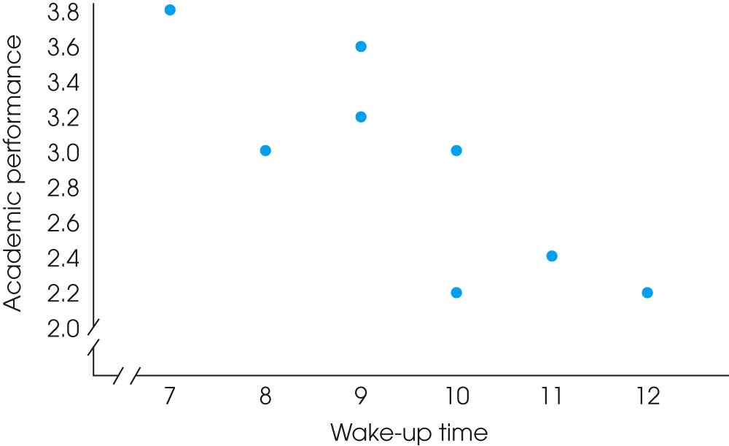
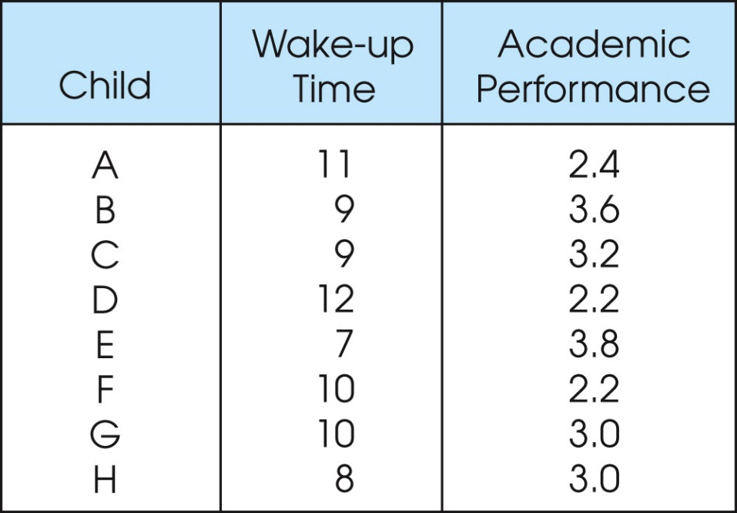
Correlational Studies

Slide 78
Experiment
The goal of an experiment is to demonstrate a cause-and-effect relationship between two variables; that is, to show that changing the value of one variable causes changes to occur in a second variable.

Slide 79
Experiment
In an experiment, one variable is manipulated to create treatment conditions.
A second variable is observed and measured to obtain scores for a group of individuals in each of the treatment conditions.
The measurements are then compared to see if there are differences between treatment conditions.
All other variables are controlled to prevent them from influencing the results.
In an experiment, the manipulated variable is called the independent variable and the observed variable is the dependent variable.

Slide 80
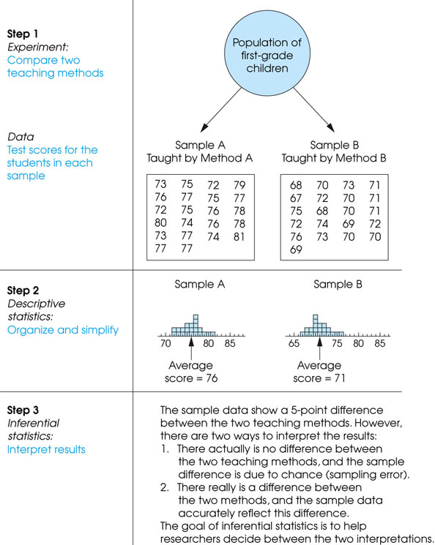

Slide 81
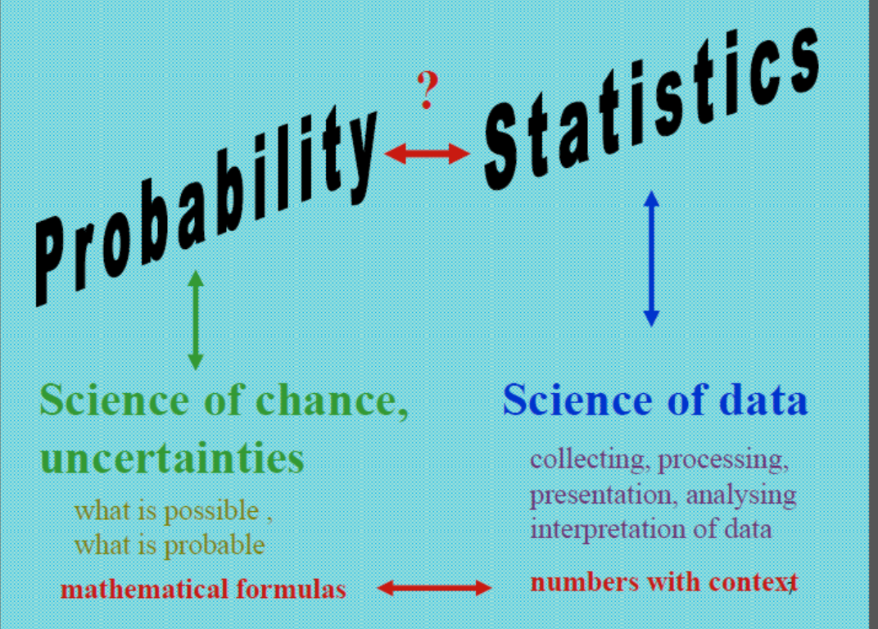

Slide 82
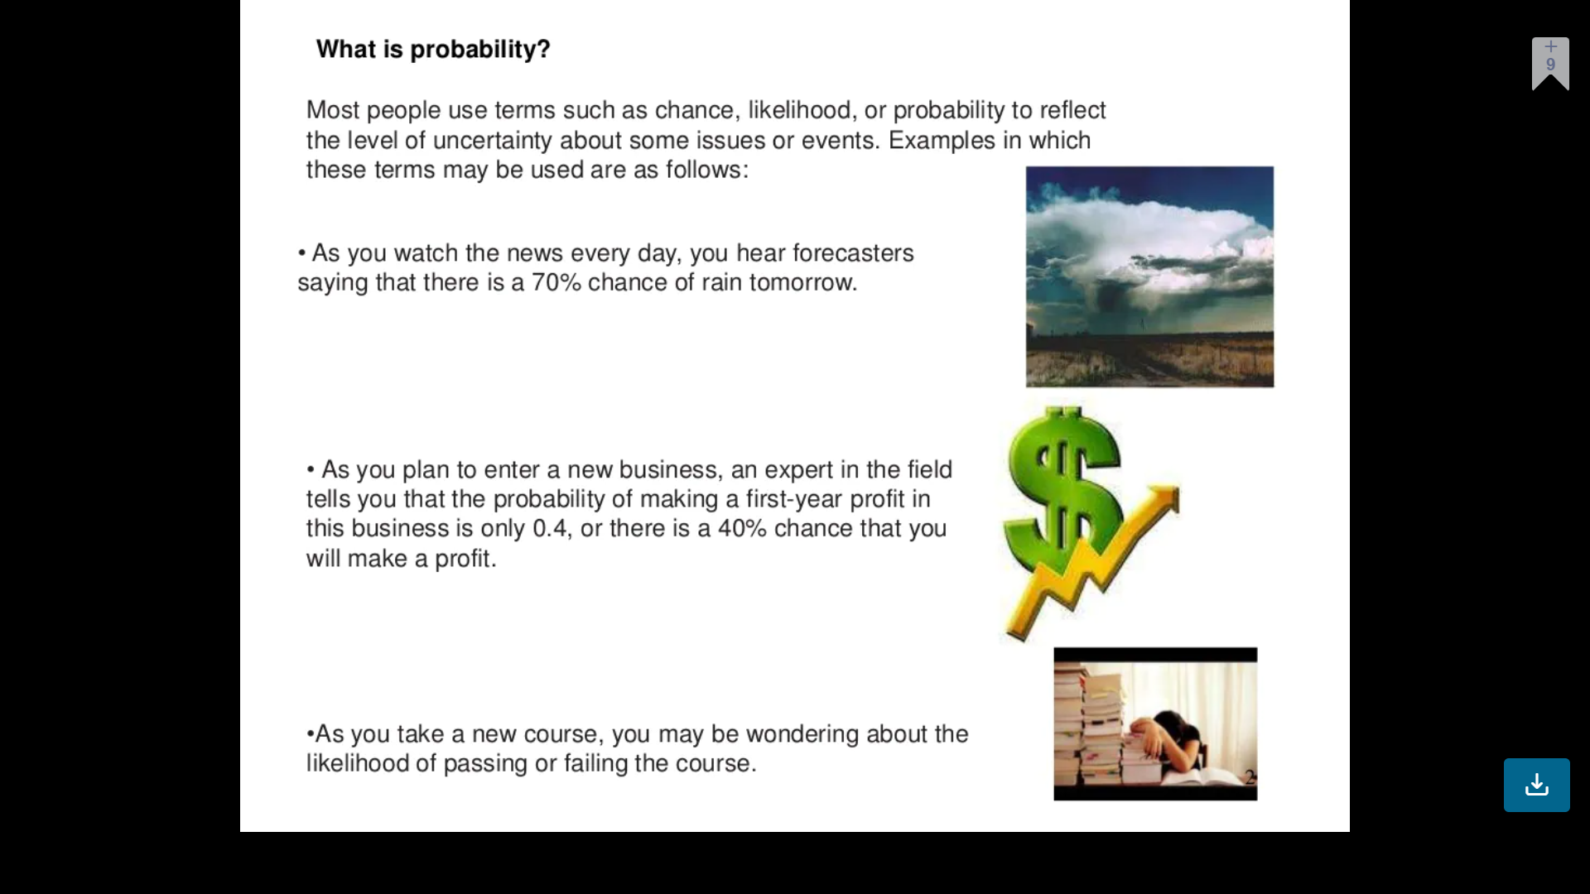
Introduction to Probability

Slide 83
Introduction to Probability

Slide 84
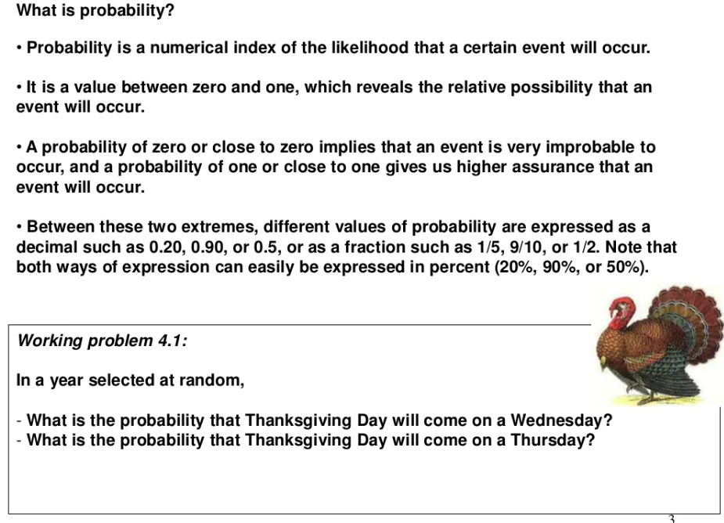

Slide 85
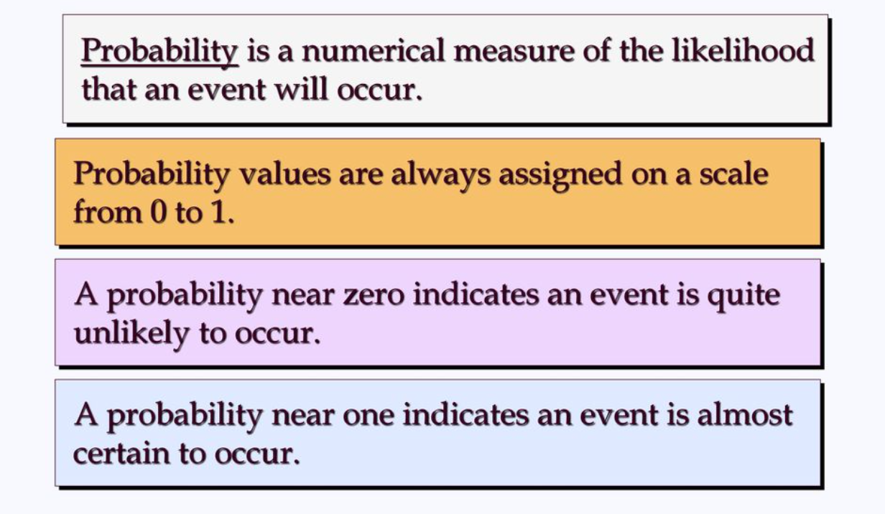
Introduction to Probability

Slide 86
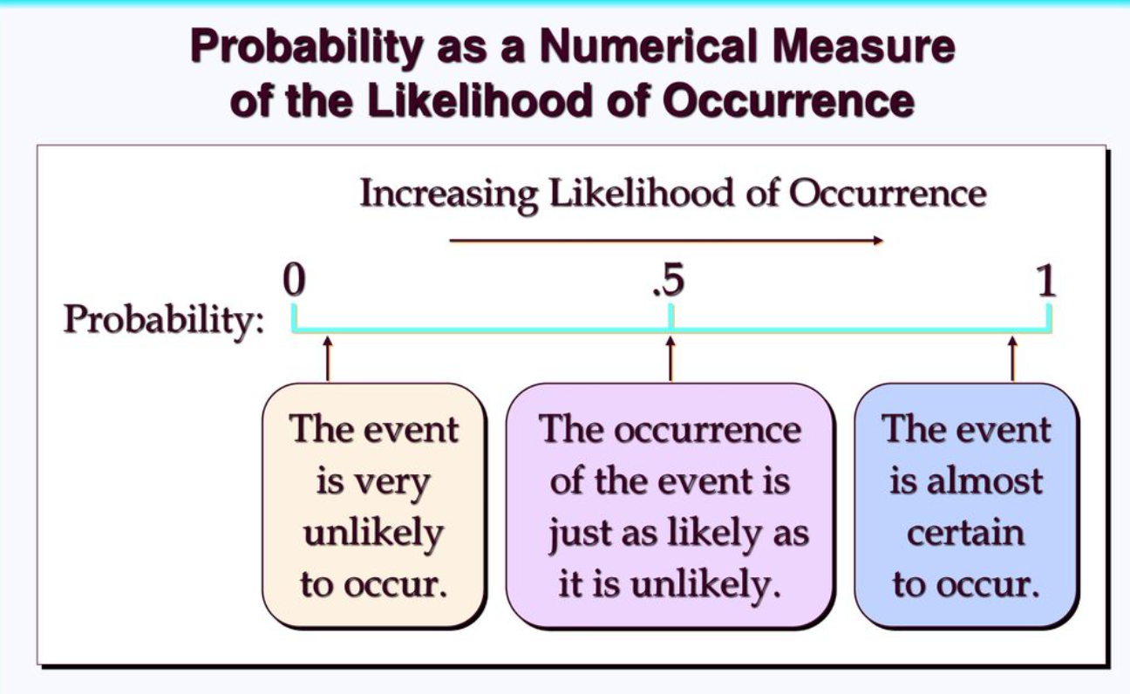
Likelihood: The chance of something happening

Slide 87
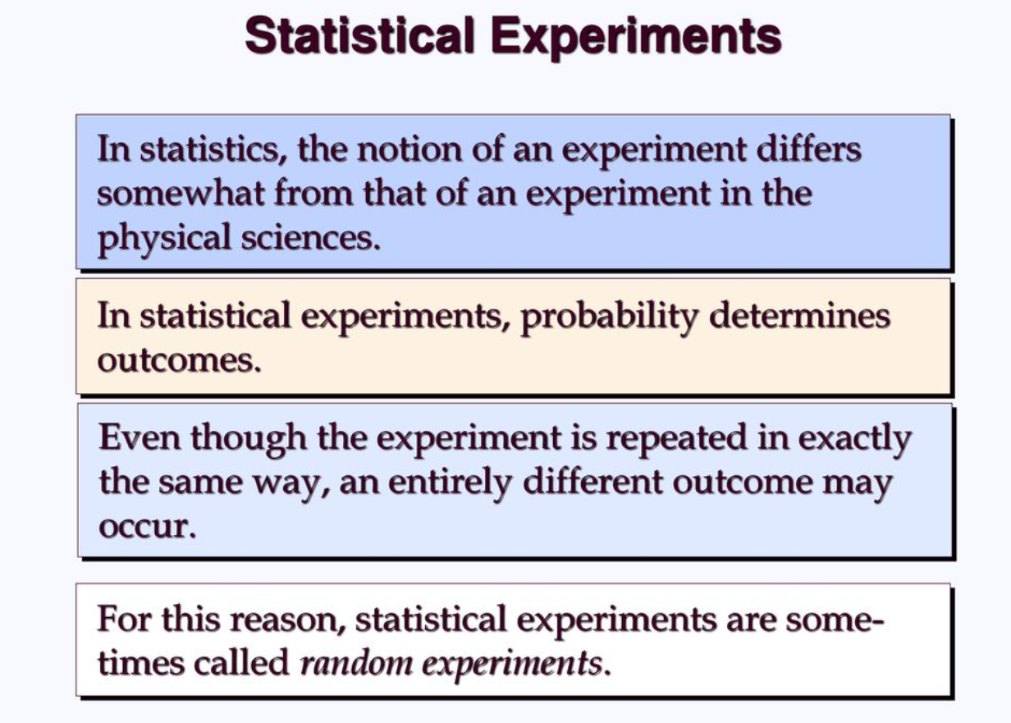

Slide 88
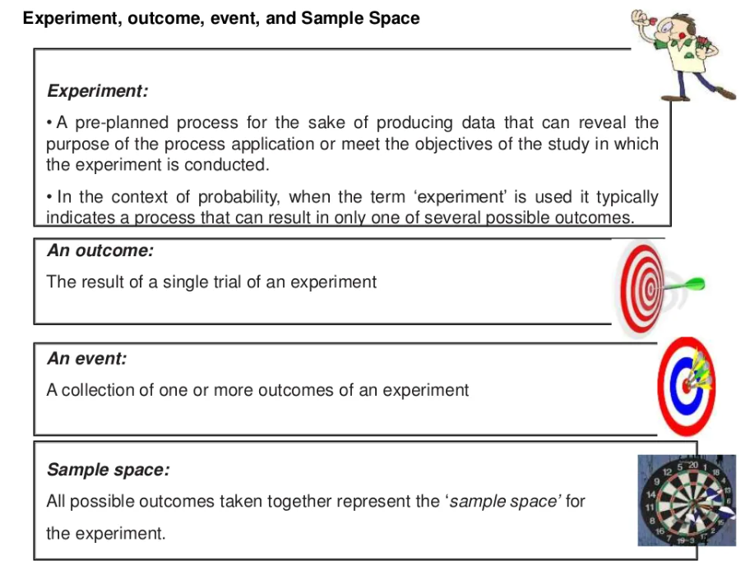

Slide 89
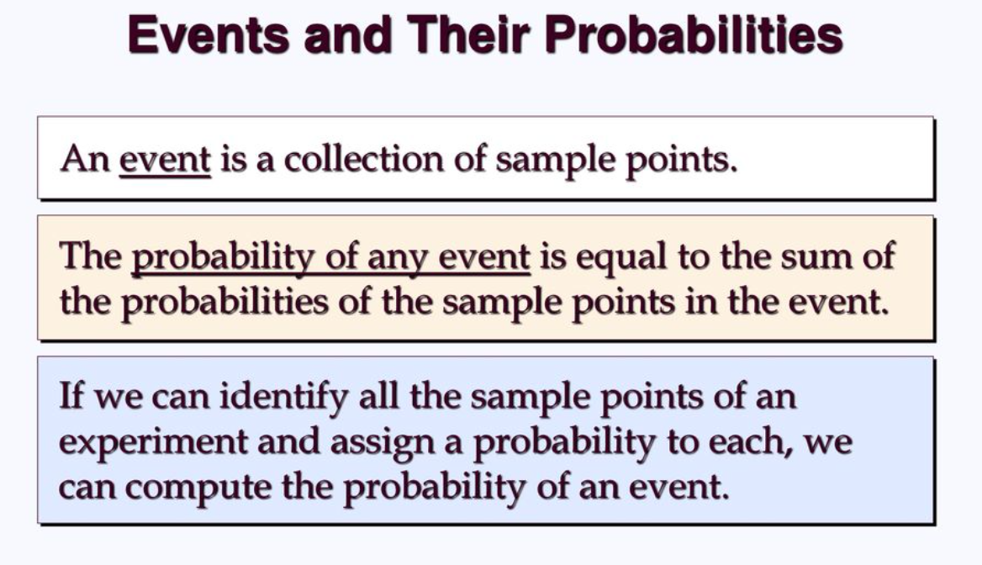

Slide 90
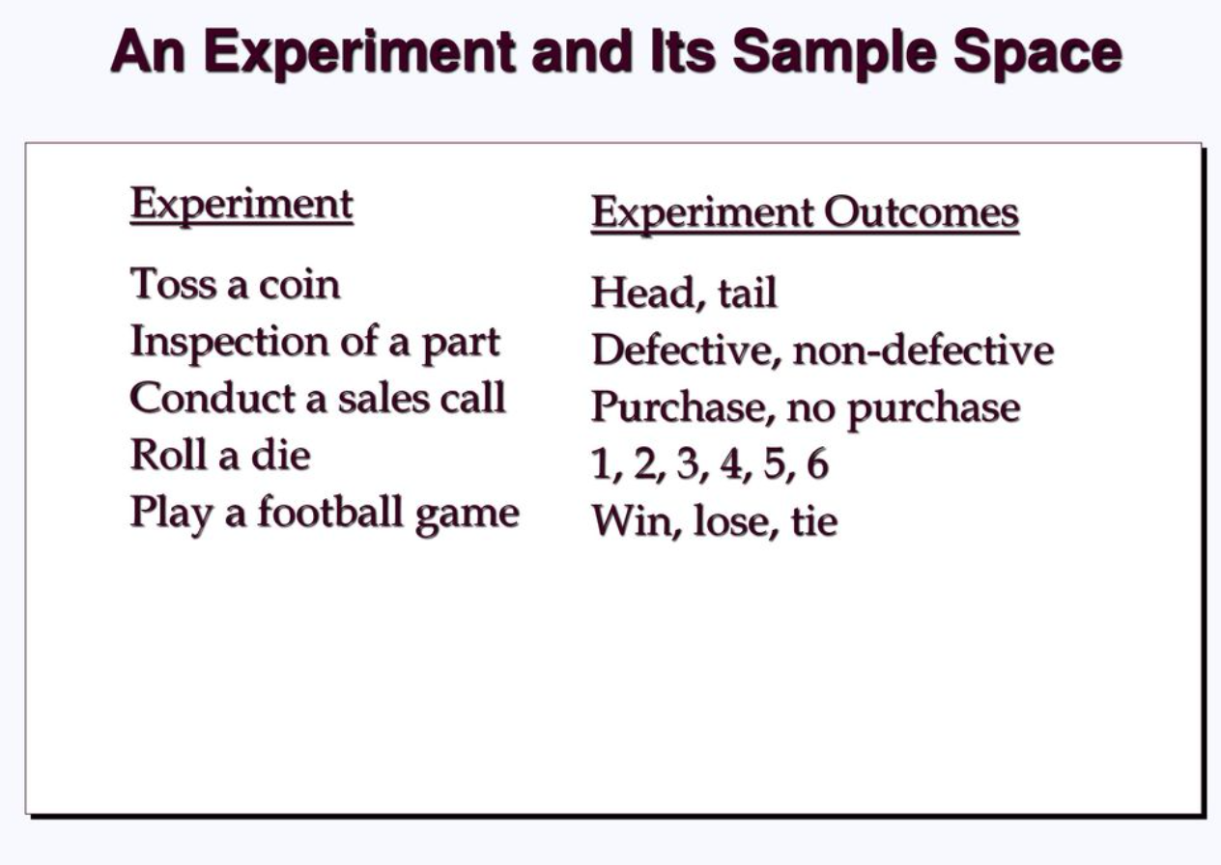

Slide 91
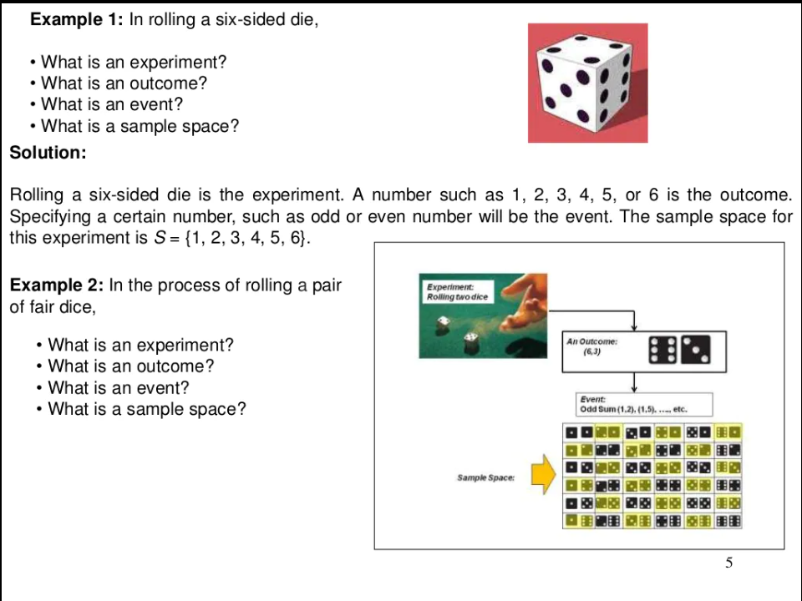

Slide 92
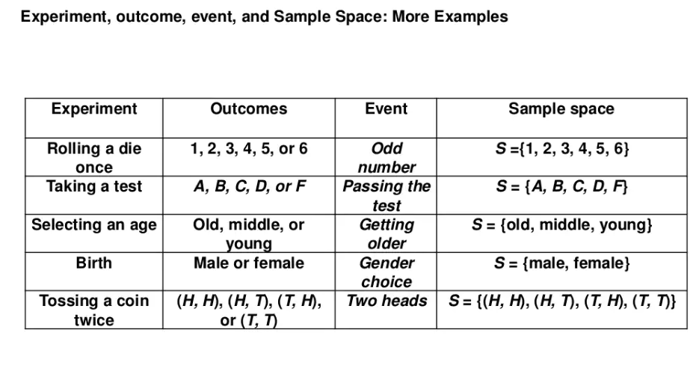

Slide 93
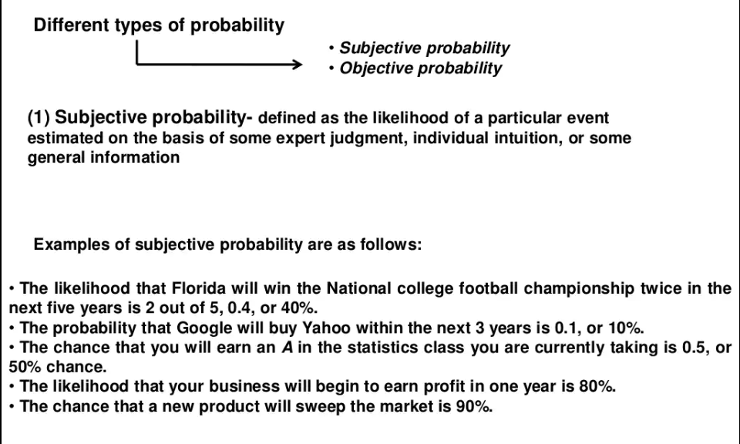

Slide 94
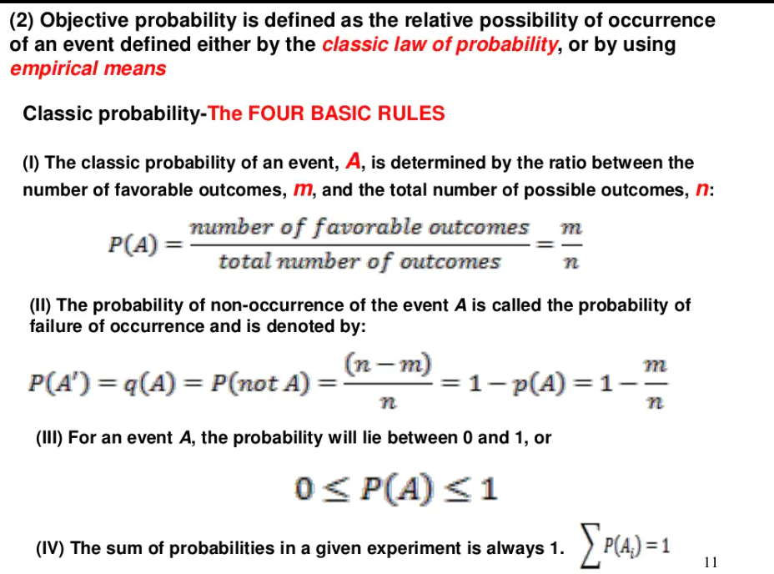

Slide 95
Types of Statistics
Descriptive statistics
Inferential statistics

Slide 96
Descriptive statistics
Descriptive statistics are methods for organizing and summarizing data. (Sample/Population)
For example, tables or graphs are used to organize data, and descriptive values such as the average score are used to summarize data.
A descriptive value for a population is called a parameter and a descriptive value for a sample is called a statistic.

Slide 97


Slide 98
Inferential statistics
Inferential statistics are methods for using sample data to make general conclusions (inferences) about populations.
Because a sample is typically only a part of the whole population, sample data provide only limited information about the population.
As a result, sample statistics are generally imperfect representatives of the corresponding population parameters.

Slide 99


Slide 100
Introduction to Hypothesis Testing
Inferential statistics is all about making decisions or judgments about the value of a particular observation or measurement.
A hypothesis is an assumption about a population parameter. It is a statement about the population that may or may not be true.
Hypothesis testing aims to make a statistical conclusion about accepting or not accepting the hypothesis.
One of the most commonly used methods for making such decisions is to perform a hypothesis test.
A hypothesis is a proposed explanation for a phenomenon. In the context of statistical hypothesis tests the term hypothesis is a statement about something that is supposed to be true.
A hypothesis test involves two hypothesis: the null hypothesis and the alternative hypothesis.
The null hypothesis (H0) (H0) is a statement to be tested.
The alternative hypothesis (HA)(HA) is a statement that is considered to be an alternative to the null hypothesis.

Slide 101
Null Hypothesis (H0):
Represents the status quo.
The hypothesis that states there is no statistical significance between two variables in the hypothesis.
Believed to be true unless there is overwhelming evidence to the contrary.
It is the hypothesis the researcher is trying to disprove.
Example:
It is hypothesised that flowers watered with lemonade will grow faster than flowers watered with plain water.
Null hypothesis:
There is no statistically significant relationship between the type of water used and the growth of the flowers.

Slide 102
Alternative Hypothesis (HA):
Inverse of the null hypothesis.
States that there is a statistical significance between two variables.
Holds true if the null hypothesis is rejected.
Usually what the researcher thinks is true and is testing
Null hypothesis:
If one plant is fed lemonade for one month and another is fed plain water, there will be no difference in growth between the two plants.
Alternative Hypothesis:
If one plant is fed lemonade for one month and another is fed plain water, the plant that is fed lemonade will grow more than the plant that is fed plain water
In hypothesis testing, we want to test is if HA is “likely” true. So, there are two possible outcomes:
Reject H0 and accept HA because of sufficient evidence in the sample in favor or HA;
Do not reject H0 because of insufficient evidence to support HA.

Slide 103
Example: The National Sleep Foundation recommends that teenagers aged 14 to 17 years old need to get at least 8 hours of sleep per night for proper health and wellness.
A statistics class at a large high school suspects that students at their school are getting less than 8 hours of sleep on average. To test their theory, they randomly sample 42 of these students and ask them how many hours of sleep they get per night. The mean from the sample is 7.5 hours. Write Null and Alternative hypothesis.
H_{o}: µ ≥ 8 hours
H_{a}: µ<8 hours
where, µ = Population mean & not sample mean

